Slide 1
CityHack 2019
Team 17 - ByteMe

Slide 2
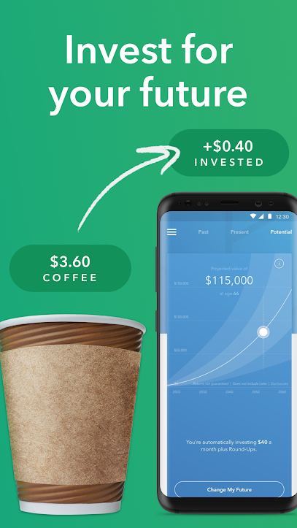
Centvest
An AI-powered micro-investment platform

Slide 3

Introduction
Centvest is a micro-investing platform, that enables individuals to round-up their daily purchases and invest in personally customized ETF portfolios.

Slide 4

Problem?
I do not have enough money to start!
There is no easy and friendly way to learn.
Consequences:
- Massive student debts
- Victims of rising inflation and housing prices in an expensive market like Hong Kong
- Lack of financial freedom leading to a financially insecure future

Slide 5





Target Audience
Millennial Students who want to invest but don’t have the necessary skill set.

Slide 6
Solution
Micro-investing
act of saving small amounts of money regularly to invest
Power of Compounding
Set-it and Forget-it Approach aka Passive Investing
Hassle-free and painless way to learn about finance
EARLY-BIRD INVESTING

Slide 7

Background
Efficient Market Hypothesis (EMH)
Predicting ETF prices
AI in finance

Slide 8
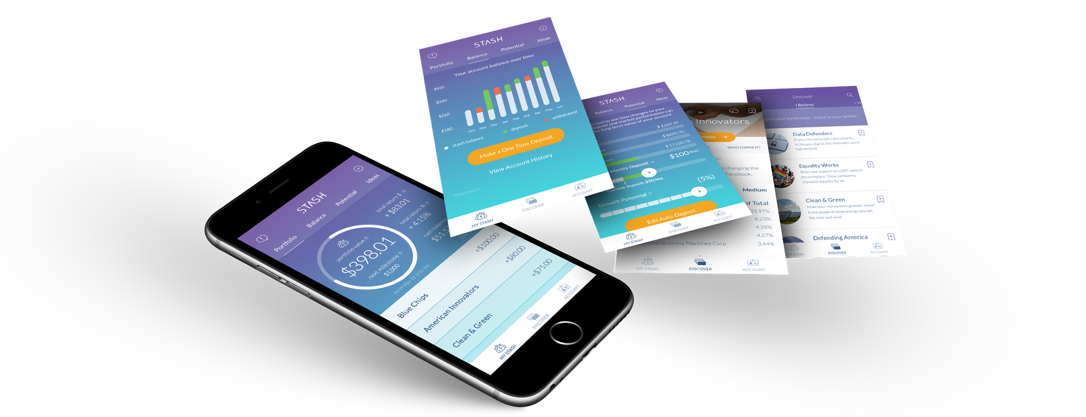
The Product
Step 1: Link your credit/debit card to the Centvest app
Step 2: Buy a Starbucks Frappuccino; we round-up the transaction to the nearest dollar and invest it.
Step 3: Where? We invest in a diversified portfolio of ETFs customized based on your risk-profile.
Conservative Risk (Lower Returns but Safer)
Moderate Risk (Balanced Risk profile)
Aggressive (High Returns but Riskier)

Slide 9


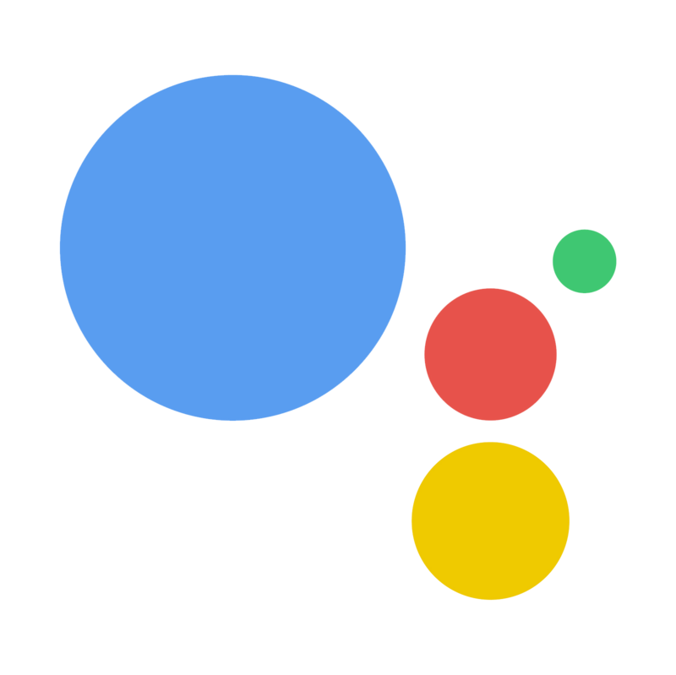


The Product
Additionally, you can learn about everything from taxes to retirement planning from the likes of Warren Buffett
Conversational UI aka Chatbots
Texting is BIG (8.3B texts sent last year)
Google’s NLP Algorithm
For regulatory and legal requirements,

Slide 10
AI/ML Algorithms and Robo-Advising
Machine Learning Algorithms for Portfolio Selection and Optimization
Support Vector Machines (SVMs)
Recurrent Neural Networks (RNNs)
ARIMA Model
Robo-advising
Digital platforms that provide automated investment strategies and solutions.
Why now?
Low-cost and more efficient
Personalized and user-friendly

Slide 11



Business Model
Free for university students (with a valid .edu address)
Subscription-based model (based on AUM)
Affiliate Marketing

Slide 12
Go-To-Market Strategy
iOS/Android platform
Target university students (18-24y demographic i.e. Millennials) across 7 UGC-funded universities (~100,000 students)
Referral Program to attract more students to join the platform.

Slide 13





Team
Vaibhav Dixit
Sameer Singh
Suhas Yogish
Prashant Sirdhar
Srinivas Sivakumar

Slide 14
Deliverables

Slide 15
ML Model and Dashboard

Slide 16
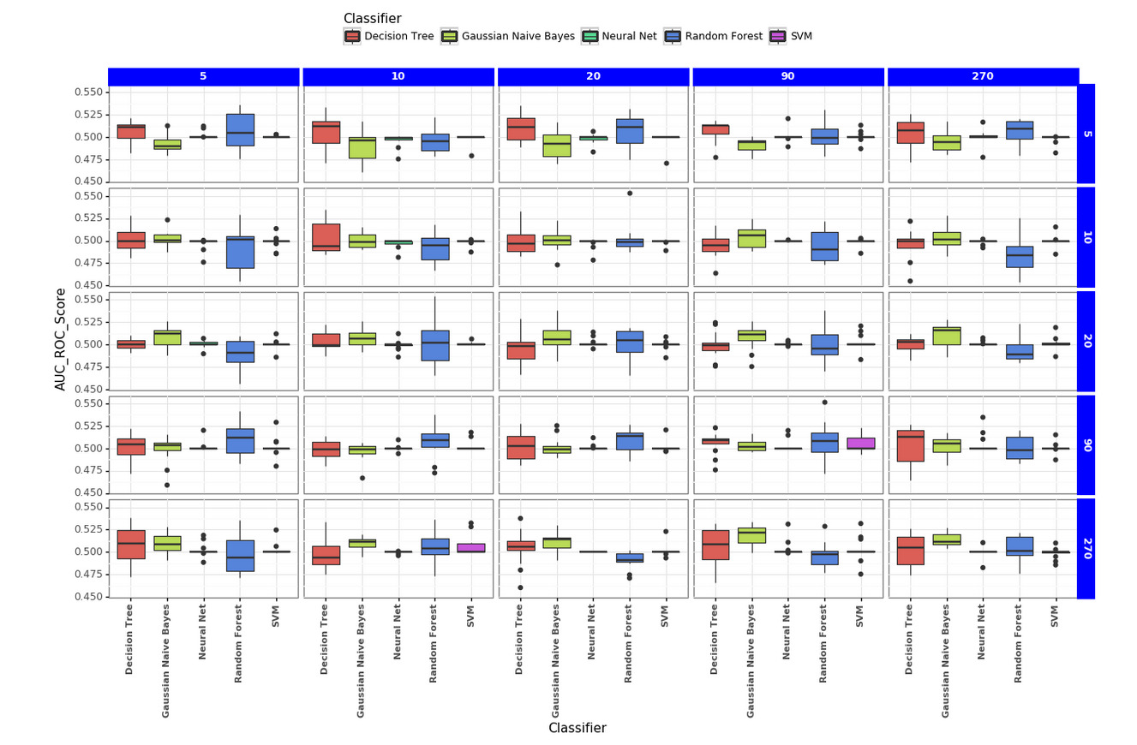
ML Model Comparison Visualization
Classifiers Used:
Decision Tree
Gaussian Naive Bayes
Neural Network
Random Forests
Support Vector Machines
The rolling windows used are a time frame of 5, 10, 20, 90 and 270 days.

Slide 17
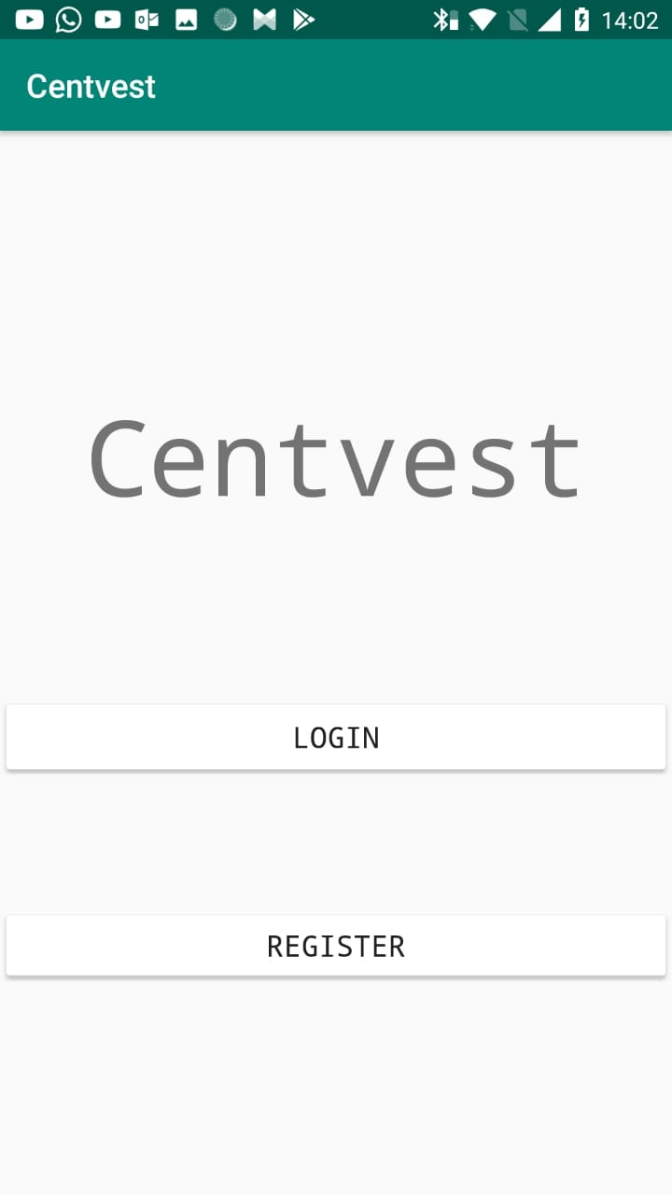
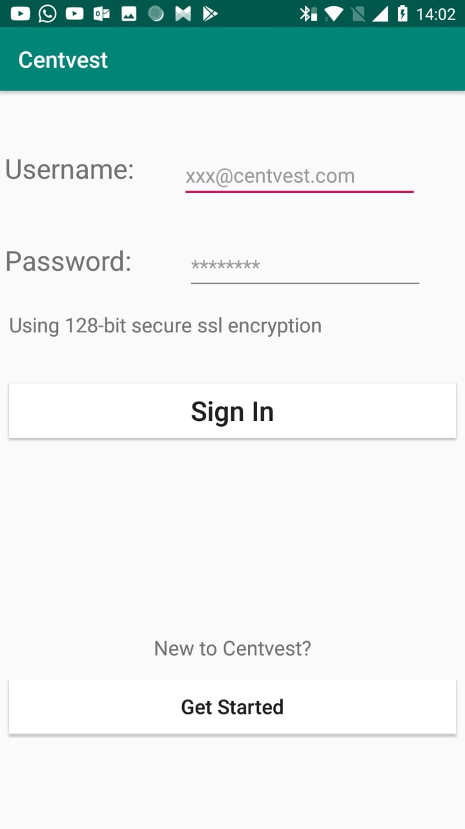
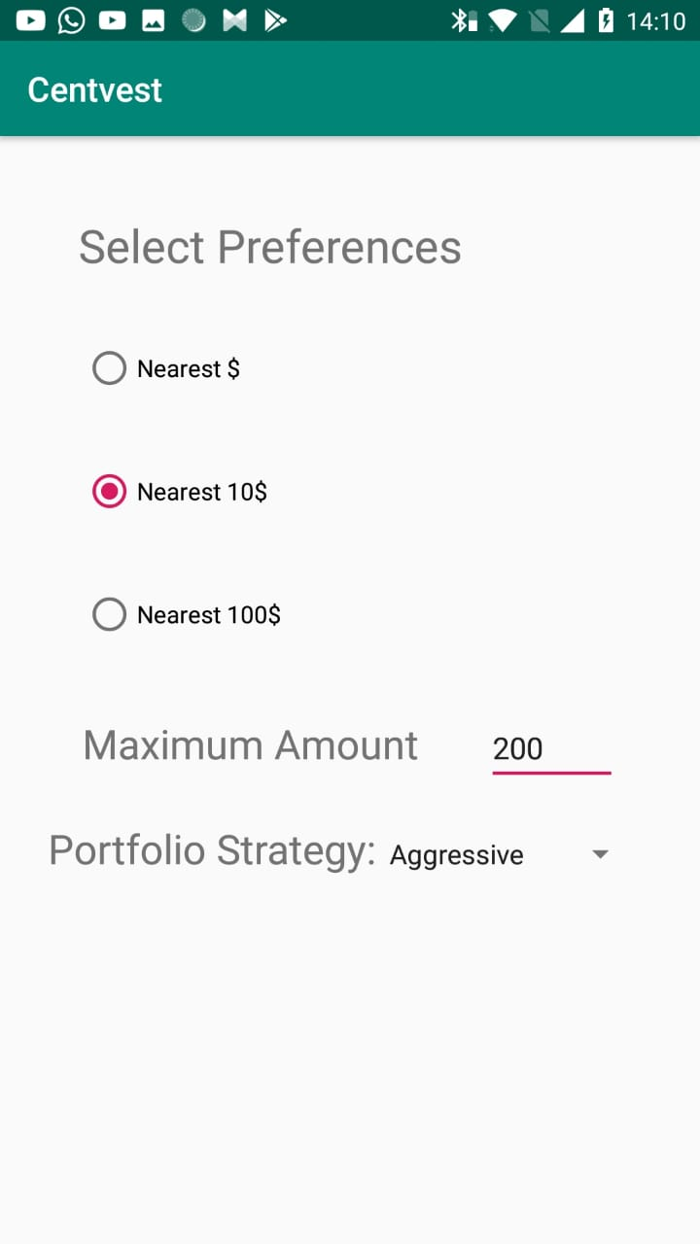
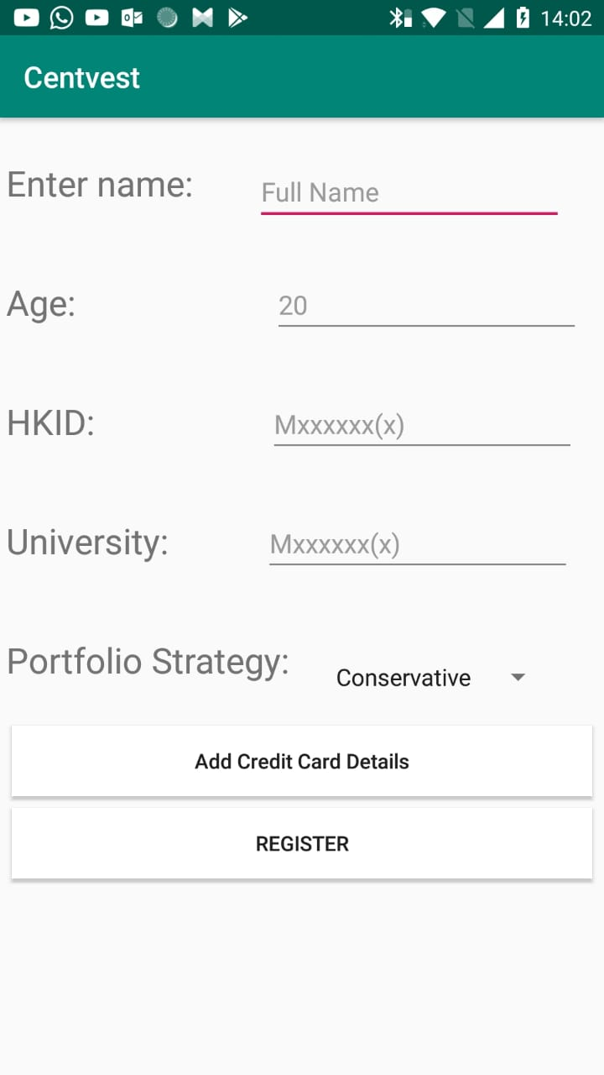
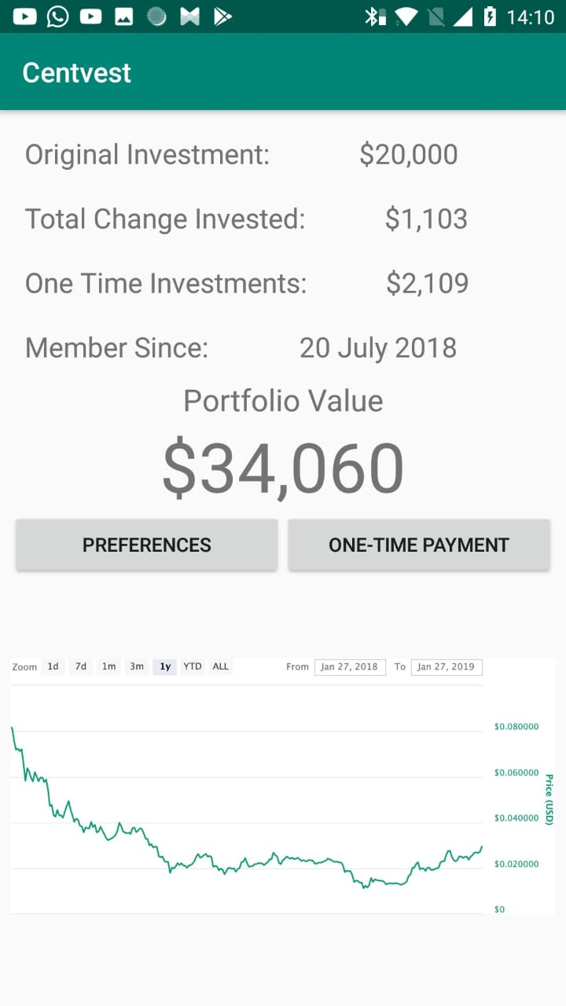
Mobile Application
Registration Screen
Home Screen
Main Screen
Login Screen
Preferences Screen

